Slide 1

Malignant Comments Classification
By: Utsav Rastogi

Slide 2

Problem Statement
The objective of this project is to use Machine learning algorithms to recognize the level of negativity a comment can instigate in an individual which could be used to help discourage users from posting potentially hurtful comments, participate in more refined arguments and make internet a safer place free from bullying and hatred.
Our dataset consists of 6 labels namely highly malignant, malignant, abuse, threat, loathe and rude. This project aims to implement various Machine Learning algorithms like Multinomial Naïve Baiyes, Logistic Regression, Linear SVC and Adaptive Boosting.

Slide 3
Data Information
There is are 2 features – “id” and “comment_text “.
“Comment_text” is an uncleaned data column which contains data that has been scraped from different social media websites.
There are 6 different labels under which comments can be tagged.
malignant | Binary column with comment labeled as malignant
highly_malignant | Binary column with labels for highly malignant text.
rude | Binary column with comment labeled as rude
threat | Binary column with comment labeled as threat
abuse | Binary column with comment labeled as abusive
loathe | Binary column with comment labeled as loathe and hateful

Slide 4
Data Pre-processing
Checking null values
Checking the number of comments in under each label
Count the number of comments having multiple labels
Lower casing text using NLTK
Word Cloud representation
Removing stop words, Tabs, Punctuation
Lemmatization

Slide 5
ML Models and Metrics
Model | Accuracy score | Cross Val Score | Hamming Loss
Logistic Regression | 91.87 | 91.98 | 0.0812
Multinomial Naïve Bayes | 90.49 | 90.74 | 0.0838
Linear SVC | 91.69 | 91.82 | 0.0831
AdaBoost Classifier | 90.7 | 90.94 | 0.0929

Slide 6
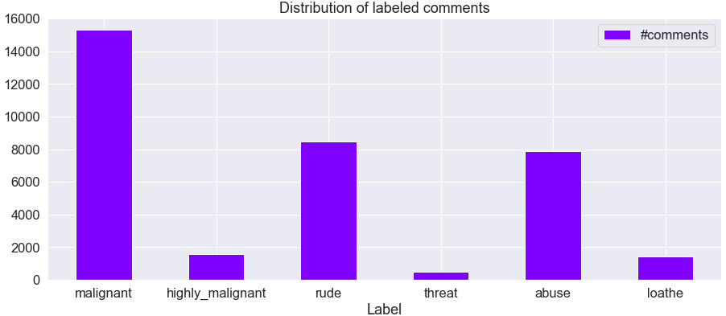
Visualizations

Slide 7
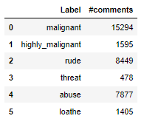
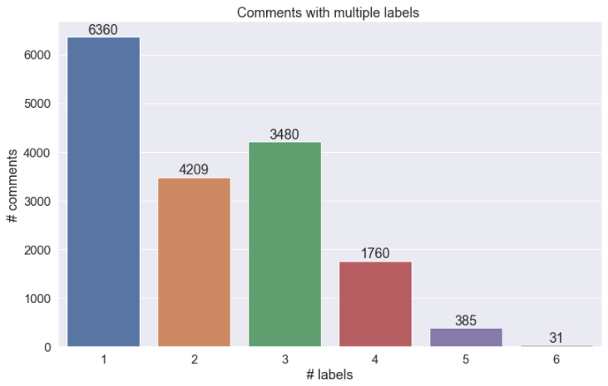
Continued

Slide 8
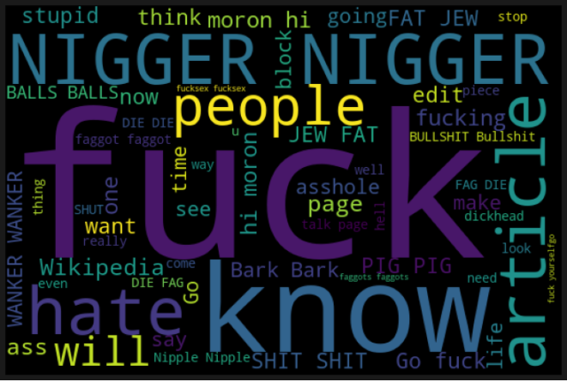
Contd.
Frequent words used in comments labelled “malignant”

Slide 9
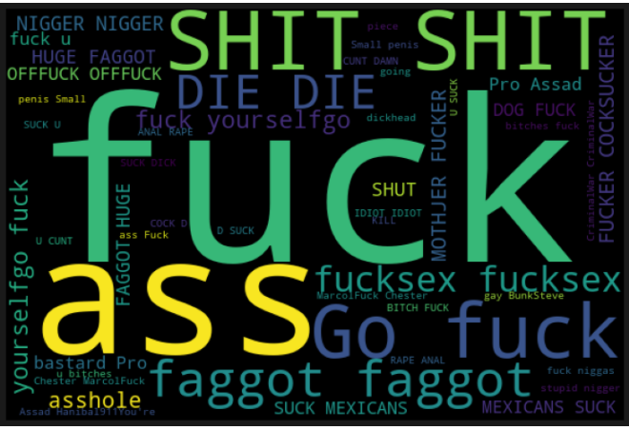
Contd.
Frequent words used in comments labelled “highly_malignant”

Slide 10
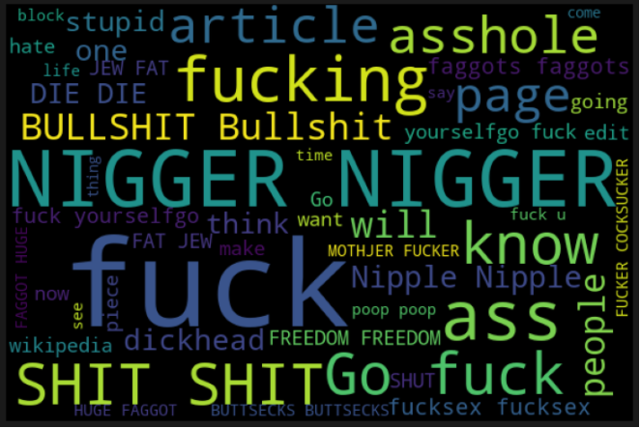
Contd.
Frequent words used in comments labelled “rude”

Slide 11
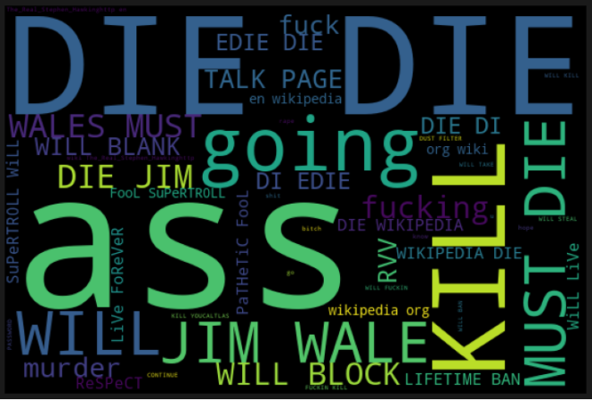
Contd.
Frequent words used in comments labelled “threat”

Slide 12
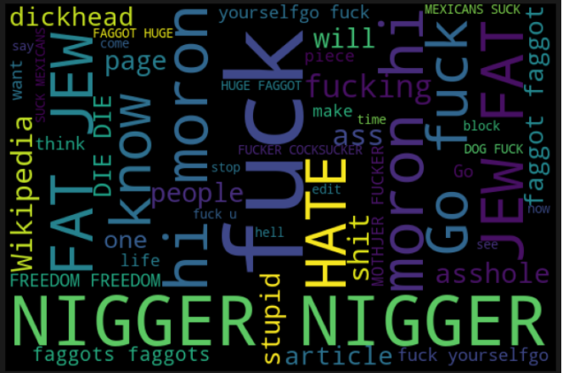
Contd.
Frequent words used in comments labelled “abuse”

Slide 13
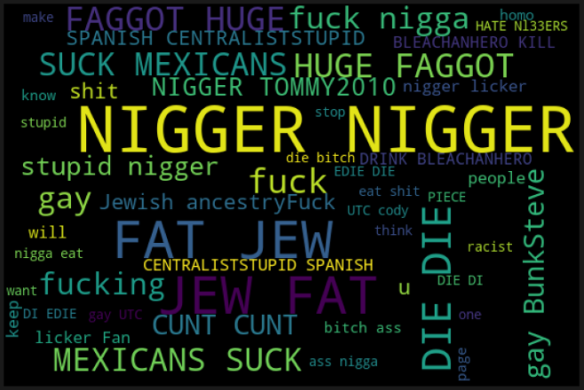
Contd.
Frequent words used in comments labelled “loathe”

Slide 14
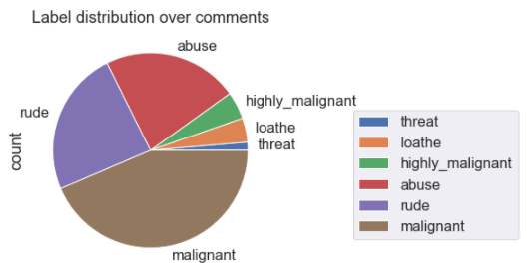
Contd.

Slide 15
Conclusion
The plots above are self-explanatory.
The number of malignant comments is the highest.
Majority of the comments have only one label associated with them.
The problem is multi label classification problem which I converted to single target column classification due to the laptop computing constraint.
The model interprets a comment and decides its range of malign (whether it belongs to only one label or have multiple labels associated with it).

Slide 16


